Slide 1
Introduction to Multivariable Calculus for Microbiology Majors
Exploring Multifaceted Changes Using Mathematical Tools

Slide 2
Introduction
Welcome to the world of multivariable calculus for microbiology majors! In this presentation, we will explore the concept of multifaceted changes and how they can be observed and analyzed using mathematical tools.
Similar to observing numerous types of microbes simultaneously, multivariable calculus allows us to examine changes that occur in multiple aspects at the same time. Think of it as a lab kit full of different tools to examine complex phenomena.
Throughout the presentation, we will use analogies to microbiology to help you better understand the mathematical concepts. Let's dive in!

Slide 3
Partial Derivatives
One of the tools in our multivariable calculus lab kit is 'partial derivatives'. It's like focusing on a single organism's behavior in a petri dish.
Partial derivatives allow us to measure how a function changes with respect to only one variable, while keeping other variables constant. This helps us understand the behavior of the function in a specific direction.
In microbiology terms, it's like observing how a single organism behaves in a controlled environment, such as a petri dish.

Slide 4
Gradient Vector
Another important tool in our multivariable calculus lab kit is the 'gradient vector'. It's like a compass that guides a bacterium towards food or away from an antibiotic.
The gradient vector helps us determine the direction of steepest increase of a function at a particular point. This concept is useful for understanding how a function changes in a given direction.
In microbiology terms, it's like understanding how a bacterium moves towards a nutrient source or avoids harmful substances.

Slide 5
Integral
Next, let's explore the concept of 'integral' in multivariable calculus. It's like finding the total bacteria occupying a specific square centimeter in a petri dish or determining the volume of bacteria in a fluid sample.
Integrals help us calculate the accumulated changes of a function over a certain interval. They provide valuable information about the total amount or volume in a system.
In microbiology terms, it's like quantifying the total number of bacteria in a specific area or measuring the volume of bacteria in a given sample.

Slide 6
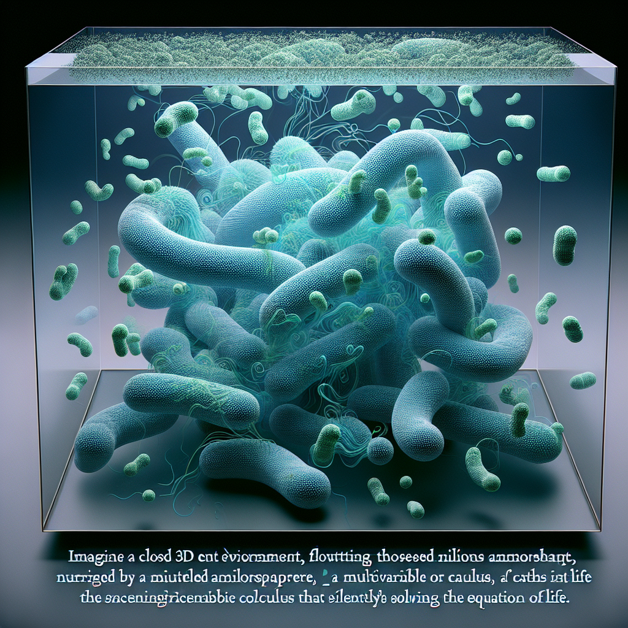
Stokes' Theorem
Let's move on to some advanced concepts in multivariable calculus. One of them is 'Stokes' theorem', which helps us understand the behavior of a bacterial population within a closed environment.
Stokes' theorem states the relationship between the flow of a vector field through a closed surface and the behavior of the vector field within the volume enclosed by the surface.
In microbiology terms, it helps us understand how bacterial population dynamics within a confined space impact the overall behavior and expansion of the population.
Stokes' Theorem

Slide 7
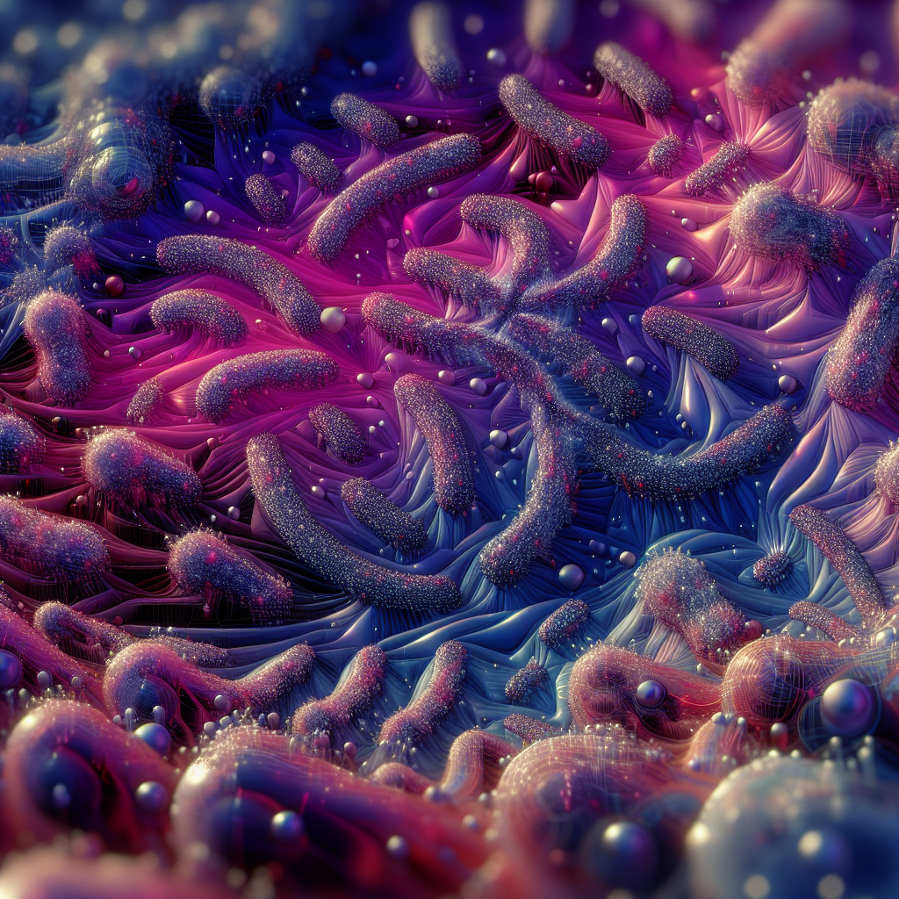
Divergence Theorem
Another advanced concept in multivariable calculus is the 'divergence theorem', which connects the flow of bacteria through a confined space to the expansion of the bacterial population in that volume.
The divergence theorem relates the flux of a vector field through a closed surface to the behavior of the vector field within the volume enclosed by the surface.
In microbiology terms, it helps us understand how the flow of bacteria within a confined space influences the growth and expansion of the bacterial population.
Divergence Theorem

Slide 8
Conclusion
In conclusion, multivariable calculus provides powerful instruments for scrutinizing and comprehending multifaceted changes in microbiology.
By using analogies like petri dishes and bacteria cultures, we can simplify complex mathematical concepts and make them easier to grasp for microbiology majors.
Remember, just like a lab kit, multivariable calculus equips you with the tools needed to explore, analyze, and understand the intricate changes happening in the microbial world. Keep exploring and enjoy the journey!

Slide 9
References
1. [Insert reference here]
2. [Insert reference here]
3. [Insert reference here]

Slide 10
Thank You
Thank you for your attention!
Any questions?

